Slide 1

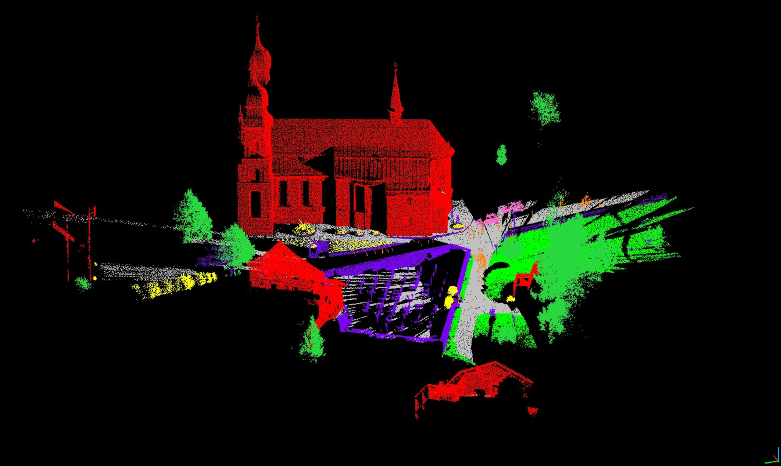
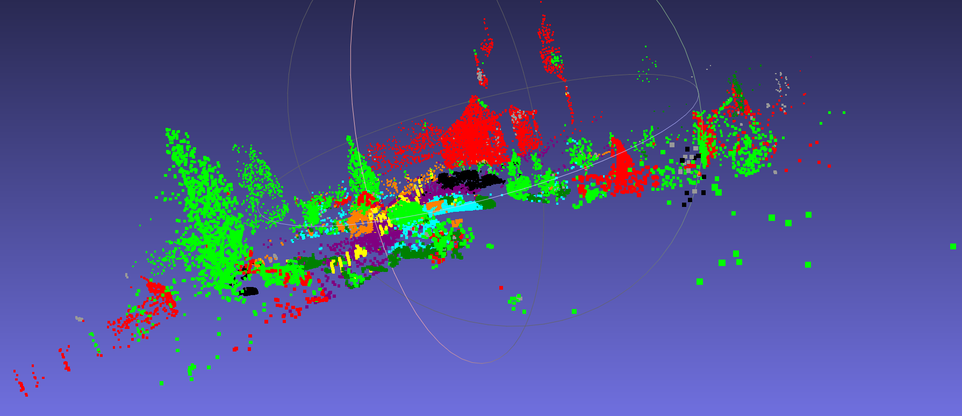
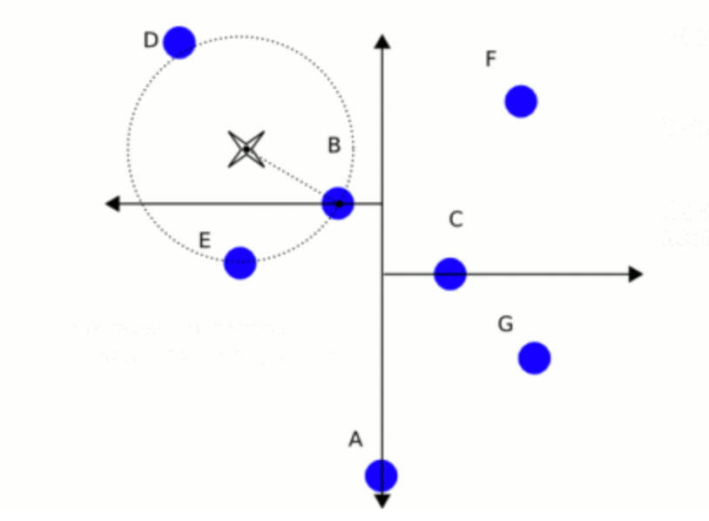
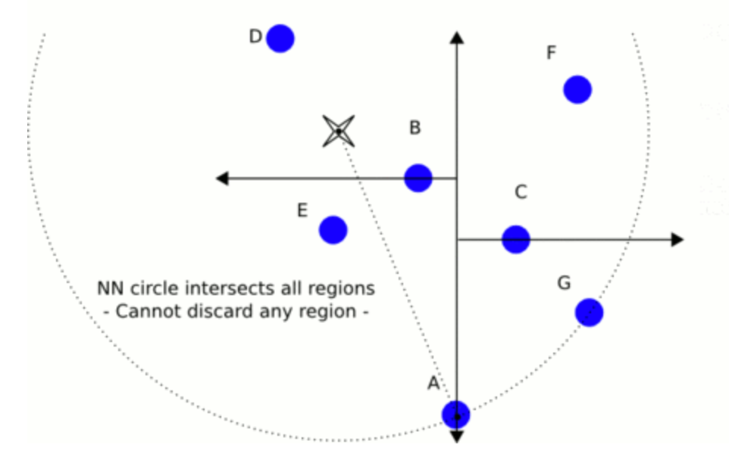
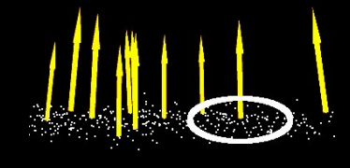
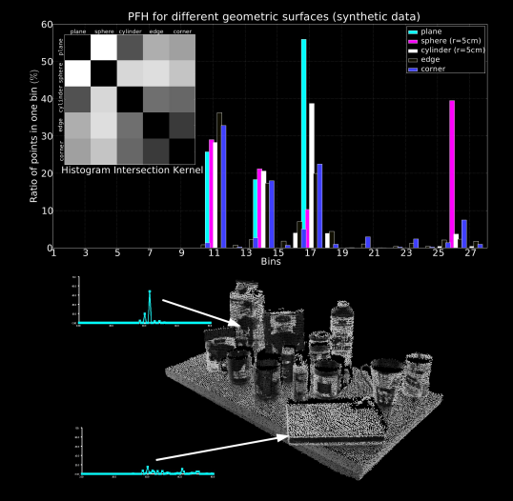
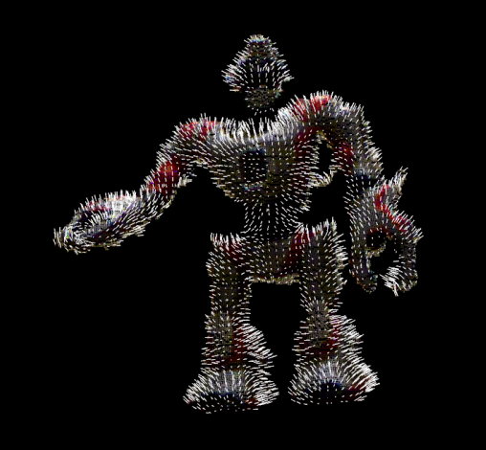
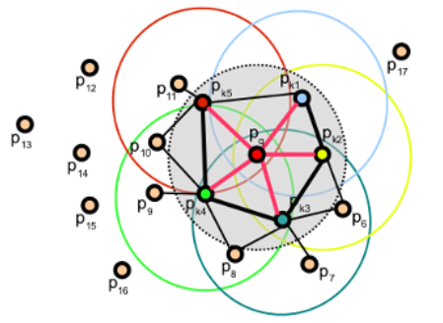
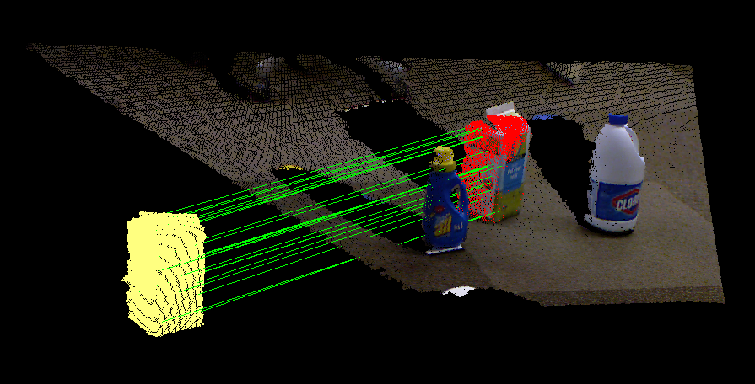
3D semantic SEGMENTATION FOR SCENE PARSING
Mingyang Zheng and Lingyu Zhang | Group 7 for course E6894, Columbia University
Project Overview
Data Preprocessing
Python Keras Neural Network Architecture
3D scanners have been largely used in 3D environment reconstruction and modelling. However, the large scale scanned data lacks of structure and semantic interpretation. Our project provides an automated approach to do semantic segmentation for 3D point cloud.
Semantic 3D dataset
The class labels are {1: man-made terrain. 2:natural terrain. 3: high vegetation. 4: low vegetation. 5: building. 6: hard scape. 7: scanning artefacts. 8: cars}
From laser zipped data to point cloud format
We use lastools to convert .laz file to ply format based on which we can implement point cloud library for further feature extraction.
Handel unbalanced multi-class data
Based on minimum number of elements.
Modify the sequence in-place by shuffling its contents to get subsampled training data.
Use random selection.
Dense(512, activation='relu')
Dense(512, activation='relu')
Dense(256, activation='relu')
Dense(128, activation='relu')
Dense(64, activation='relu')
Dense(9, 'softmax')
Dropout(0.1)
Firstly, we estimated the shape outline through SIFT3D keypoint extraction and normal estimation, we extracted the local feature of the point cloud and then reduce the 3D image dimension from three to one. Then we build one neural network model for the semantic label classification. Finally, we re-projected the 1vector with predicted label to 3D point cloud for color visualization
Dropout(0.1)
C++ Feature Vector Extraction
Step 1
SIFT3D, FPFH: dimension transform and feature vector extraction
Step 2
network for point level classification
Project labeled data to reform 3D point cloud for color visualization
Step 3
Key point localization. – SIFT 3D
Lots of them, Repeatable, Representative orientation, Fast to extract and match.
Semantic Labeled 3D Data Visualization
Dynamic scale adjusting based on maximum distance in point cloud.
The scale for the determination of a point’s neighborhood has to be selected based on the level of detail required by the application
Apply color coding for point-wise labeling result.
Construct XYZRGB 3D mesh and do visualization using meshlab.
Local feature extraction. – Fast point feature histogram
FLANN-based KdTree for nearest neighborhood searches.
Using a Numpy array for each point to represent curvature and correlation with its neighbors.
.
Characteristics & Innovation
Point level standalone shape outline prediction
3D position information is transferred into feature vector
Neural network with vector as input
Simple architecture, small model size, short training time with decent accuracy
Design Space Exploration
Feature Extraction
Dimension
GRB feature
Network Design
Bypass
Depth
Dataset Parameter
Point cloud sampling rate
Training set size
[1] Point Cloud Library. http://pointclouds.org/
[2] Semantic3D dataset. http://www.semantic3d.net/view_dbase.php?chl=1

